Slide 1
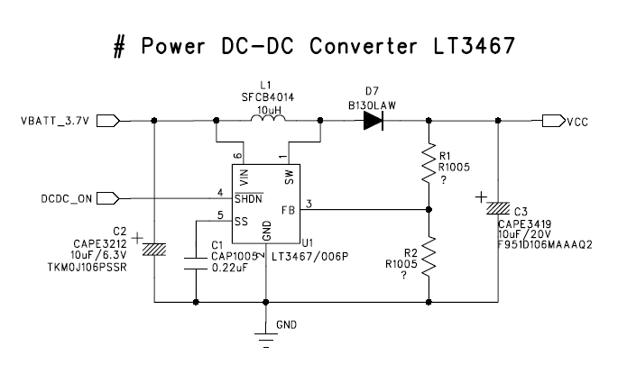
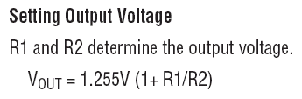
LT3467 DC-DC converter circuit(050909)
Power Block for 1.3”, 1.5” or 1.77” OLED Unit
VOUT | R1 | R2
16 | 390K | 33K
15 | 470K | 43K
14 | 510K | 51K
13 | 470K | 51K
12 | 330K | 39K

Slide 2
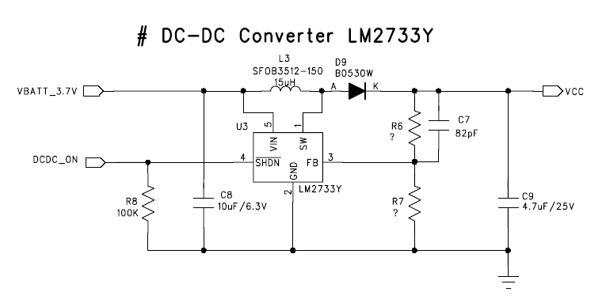
LM2733 DC-DC converter circuit(050909)
Power Block for 1.04” or 1.17 OLED Unit
VOUT | R6 | R7
20 | 300K | 20K
19 | 560K | 43K
18 | 300K | 22K
17 | 360K | 30K
16 | 360K | 30K
15 | 270K | 24K
14~13 | 360K | 36K

